Slide 1
Exercises
7) In the industrial preparation of hydrogen trioxonitrate (V) acid, ammonia gas NH3, is burned in oxygen O2, in the presence of a catalyst according to the following equation:
4NH₃(g) + 5O₂ 4NO(g) + 6H₂0(g)
If 260cm³ of NH₃ are burned completely, what volume of
O₂ is used up?
b) NO is produced.
a. 325cm³, b. 260cm³
8) 20cm³ of CO are mixed and sparked with 200cm³ of air containing 21% of O₂. If all the volumes are measured at s.t.p., calculate the total volume of the resulting gases.
210cm³

Slide 2
Exercises
SOLUTION
Volume of oxygen: (21/100) X 200 = 42cm³ Volume of nitrogen and other gases that did not take part in the reaction = 200 – 42 = 158 cm³ Equation for the reaction 2CO + O₂ → 2CO₂ Ratio: 2 : 1 : 2 Initial volumes: 20cm³ 42cm³ -- Volumes used up: 0cm³ 10cm³ 20cm³
Note
- The 0cm³ means that all the volume of CO has been used up
Only 10 cm³ of O₂ was used (based on molar ratio of 2:1)
Volume of oxygen that did not react: 42 – 10 = 32 cm³
Then, volume of d resulting gas = volume that did not take part in the reaction with oxygen+ unreacted volume of O₂+ volume of the product
= 158 + 32 +20 = 210cm³

Slide 3
Quantitative Analysis
Calculate the mass of sodium hydroxide in 5.00 dm³ of a 0.125 mol dm⁻³ solution. [NaOH = 40 g mol⁻¹]
Options
A) 0.0156 g
B) 0.625 g
C) 1.00 g
D) 25.0 g
Solution
If 1 moldm⁻³ of NaOH = 40g.
Mass of NaOH in 0.125mole = 0.125 x 40 = 5g.
Mass in 5.00 dm³ of the solution = 5 x 5 = 25.0g.

Slide 4
Quantitative Analysis
When 50cm³ of a saturated solution of sugar (molar mass 342.0g) at 40ºC was evaporated to dryness, 34.2g of dry solid was obtained. The solubility of sugar at 40ºC is
A. 10.0 moles dm⁻³
B. 7.0 moles dm⁻³
C. 3.5 moles dm⁻³
D. 2.0 moles dm⁻³
Solution
Note that solubility is the same as molarity, (both measured in mol/dm³)
Solubility (Molarity) = number of moles / volume(dm³)
Change the volume to dm³ = 50/1000 = 0.05dm³
No of moles = mass/molar mass = 34.2/342 = 0.1
Hence, Solubility = 0.1 / 0.05 = 2 moldm⁻³

Slide 5
Quantitative Analysis
200cm³ each of 0.1M solutions of lead (II) trioxonitrate (V) and hydrochloric acid were mixed. Assuming that lead (II) chloride is completely insoluble, calculate the mass of lead (II) chloride that will be precipitated. [Pb = 207, Cl= 35.5, N = 14, O = 16]
A. 2.78g
B. 5.56g
C. 8.34g
D. 11.12g

Slide 6
Exercises
Solution Pb(NO₃)_{2(aq)} + 2HCl_{(aq)} ---> PbCl_{2(s)} + 2HNO_{3(aq)} 1 mole of Pb(NO₃)₂ = 1 mole of PbCl₂
Molar concentration = no of moles/volume in dm3
No of moles = molar concentration x volume in dm3
molar concentration of Pb(NO₃)₂ = 0.1M volume of Pb(NO₃)₂ in dm3 = 0.2 dm3 therefore, no of moles of Pb(NO₃)₂ = 0.1M x 0.2 dm3 = 0.02 mol but from the balanced equation of the reaction, 1mol of Pb(NO₃)₂ gave 1mol of PbCl₂, therefore 0.02mol of Pb(NO₃)₂ will give 0.02mol of PbCl₂. But using, no of moles = mass/molar mass, therefore mass = no of moles x molar mass where, no of moles of PbCl₂ = 0.02mol molar mass of PbCl₂ = 207 + (2 * 35.5) = 278 g/mol therefore, mass of PbCl₂ = 0.02mol * 278g/mol = 5.56g therefore, mass of PbCl₂ that precipitated out is 5.56g.

Slide 7
Chemical Bonding

Slide 8
Learning Outcomes
At the end of this session, students should be able to:
Explain the formation of chemical bonds.
Define and give examples of ionic, covalent and metallic compounds.
Relate the structures of simple compounds to their properties and applications.

Slide 9
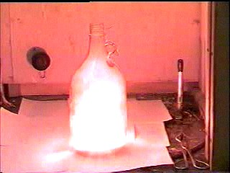
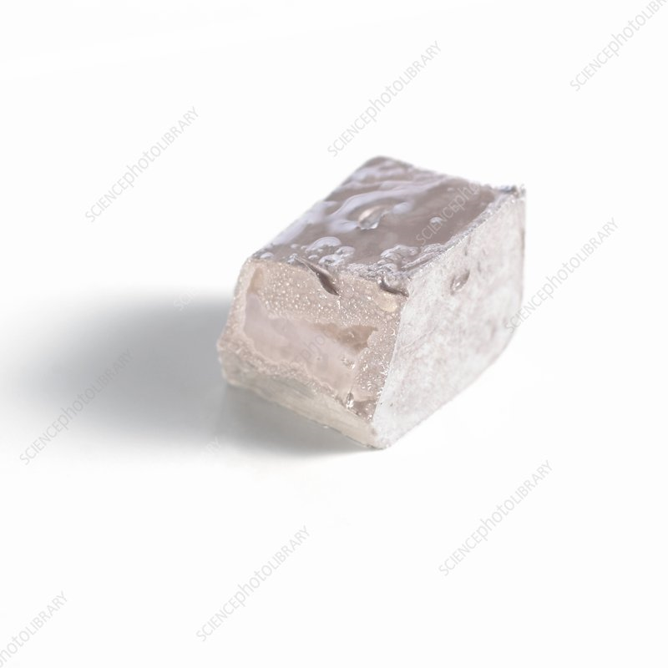
Introduction
Tarnished Sodium metal
Sodium burning when put into a jar of chlorine gas

Slide 10
Chemical Bonding
Chemical bonding involves an attraction which can be between
cations and anions - ionic bond.
the nuclei and shared electrons - covalent bond.
the metal ion and delocalized electrons - metallic bond. In other words
Metals bond to non metals ionically.
Non metals bond covalently.
Metals bond to themselves metallically.
The three types of bonding all involve interactions and they are electrostatic in nature.

Slide 11
Ionic Bonding
The description of bonding in terms of ions (ionic model) is
particularly appropriate for describing binary compounds
formed from a metallic element, especially an s-block metal and a nonmetallic element.
Recall the ionic solid of NaCl which is made of sodium and chloride ions stacked together in alternate but regular array.
Here, emphasis is on changes in the valence electrons that accompany the formation of ions and the energetics of the formation of ionic solids.

Slide 12
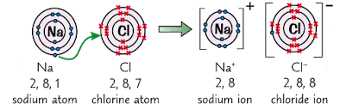
Ionic Bonding

Slide 13
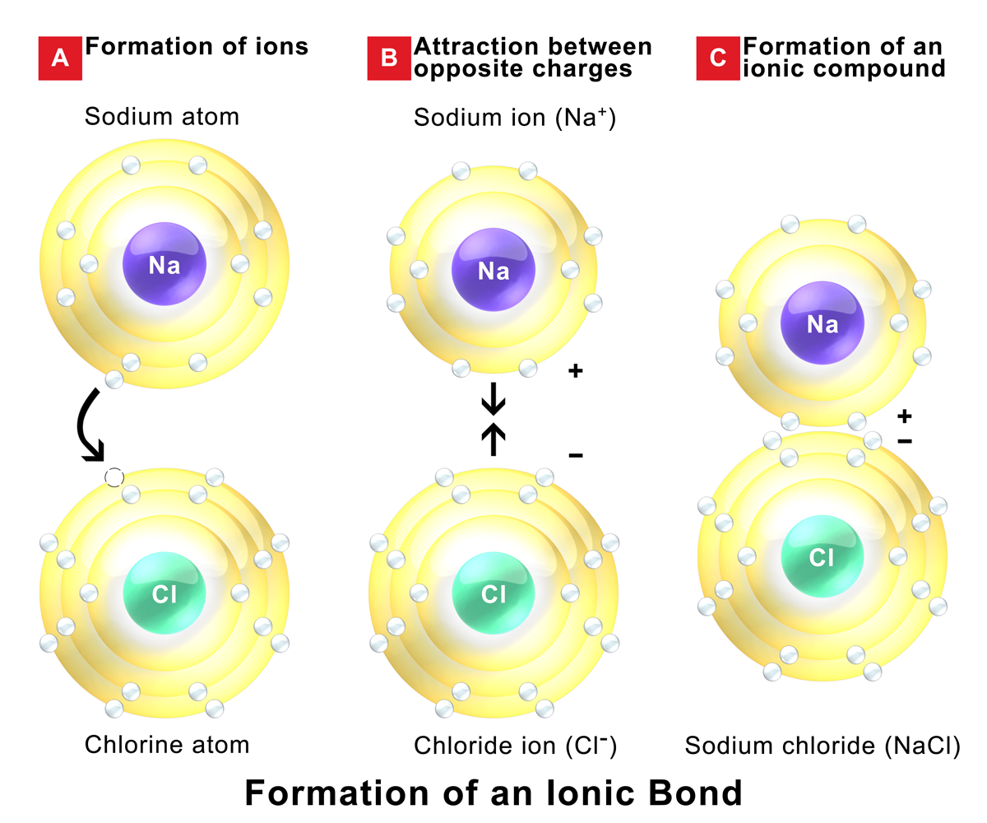
Ionic Bonding

Slide 14
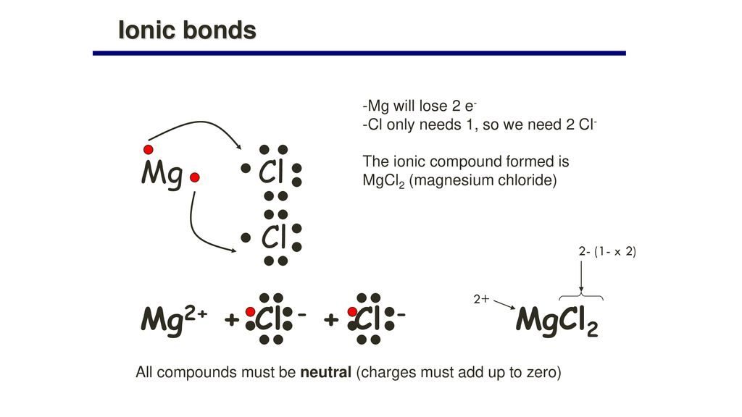

Slide 15
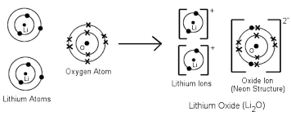
Ionic Bonding

Slide 16
Ionic Bonding
Both the Na⁺ and Cl⁻ attain the noble gas electronic configuration which gives rise to stability.
Strong electrostatic attraction links Na⁺ and Cl⁻ together.
Because of their opposite charges, Na⁺ and Cl⁻ are attracted to each other by ionic bonds and the compound formed is called ionic compound.

Slide 17
Ionic Bonding
Ionic bonds can therefore be defined as strong non directional electrostatic forces of attraction formed between positive and negative ions.
non-directional implies that the pull of the electrons does not favor one atom over another.
The elements of Group IA and IIA form cations readily while those of Groups VIA and VIIA form anions readily.

Slide 18
Ionic Bonding
Elements in the same group of the periodic table have similar properties/reactivities
because in most cases, they have the same number of valence electrons which are the ones with which they interact with others.
they’ll form similar ions and perform similar roles in ionic compounds.

Slide 19
Formation of Ions
An atom of a metallic element forms a cation when it loses electrons down to its noble-gas core.
In general, that core has an ns² np⁶ outer electron configuration, which is an octet of electrons.
For example, sodium ([Ne]3s¹ ) loses its 3s-electron to form Na⁺, which has the same electron configuration as neon, [Ne] or 1s² 2s² 2p⁶ .
The sodium ion, Na⁺ cannot lose more electrons in a chemical reaction, because the ionization energies of core electrons are too high.

Slide 20
Writing electronic configuration of ions
Procedure
Determine the configuration of the neutral atom from its position in the periodic table.
Remove electrons from the valence-shell p-orbitals first,
Remove electrons from the s-orbitals, and finally, if necessary,
Remove electrons from the d-orbitals in the next-lower shell,
until the number of electrons removed equals the charge on the ion.

Slide 21
A system that is lower in energy is considered more stable.
The energetics (or thermodynamics) tell us if a reaction is likely to proceed and how far. Another important factor to consider is how FAST a reaction will go, also called KINETICS.
There is a barrier to getting a reaction started called the activation energy. Before the new bonds can form, some of the old bonds must be broken. (This is also why a spark is required to start a flame.) If the reaction energy barrier is larger, the reaction will be slower.
Every chemical reaction needs activation energy to start.

Slide 22
Energetics of the formation of ionic compounds
A measure of the bond strength in an ionic compound is known as Lattice energy
defined as the energy required to separate a mole of an ionic solid into gaseous ions OR
amount of energy released upon formation of a crystalline ionic solid from gaseous ions OR
the heat of formation for ions of opposite charges in the gas phase to combine into an ionic solid.
The charge and radius of the bonded ions are the two major factors that contribute to the magnitude of the lattice energy.
as the charge of the ions increases, the lattice energy increases.
as the size of the ions increases, the lattice energy decreases.

Slide 23
Energetics of the formation of ionic compounds
Lattice energy cannot be determined experimentally due to the difficulty in isolating gaseous ions.
The energy value can be estimated using
the Born-Haber cycle, (which shows the step-wise process of lattice formation from elements) or
calculated theoretically with an electrostatic examination of the crystal structure.

Slide 24
Energetics of the formation of ionic compounds
Two different approaches are normally considered in the formation of ionic compounds:
Elements being seen as reacting directly at standard conditions to give the ionic compounds,
in which case the enthalpy change involved is known as standard enthalpy change of formation (represented as ΔHº_{f}) of the ionic compound. Example
Na(s) + 1/2Cl₂(g) → NaCl(s) ΔH_{f}º = -410.9 kJ

Slide 25
Energetics of the formation of ionic compounds
2) Considering the formation of ionic compounds via a series of steps:
Conversion of the elements to gaseous state (standard enthalpy change of vaporisation ΔH⁰_{vap} or atomization ΔH⁰_{atom}).
Conversion of the gaseous atoms to ions (the ionisation enthalpy ΔH_{I.E.} and electron affinity ΔH_{E.A.}).
Combination of the gaseous ions to give the ionic crystals (the lattice enthalpy ΔH⁰_{lattice}).

Slide 26
Ionic Compounds
Energetics of sodium and chloride ions
Removing an electron from Na_{(g)} to form Na⁺_{(g)}
Na_{(g)} → Na⁺_{(g)} + e⁻ ΔE = +496 kJ/mol
Adding an electron to Cl_{(g)} to form Cl⁻_{(g)}
Cl_{(g)} + e⁻ → Cl⁻_{(g)} ΔE = -349 kJ/mol
Attraction between the unlike charges draws ions together causing energy to be released.
Heat of formation of ionic substances is quite exothermic

Slide 27

Examples of Ionic Compounds
Formation of magnesium chloride (MgCl₂)
The electronic configuration of magnesium (Atomic. No. 12) is 2,8,2.
It has two electrons in its valence shell.
The electronic configuration of chlorine (Atomic. no. 17) is 2,8,7.
It has seven valence electrons.
In terms of the Lewis (electron dot) structures, one can write:

Slide 28
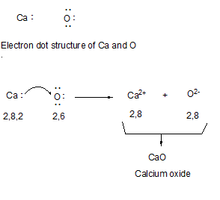
Examples of Ionic Compounds
Formation of Calcium oxide (CaO)
Calcium oxide (quicklime) is a substance largely used in chemical industry as intermediary in the cement and concrete production and also in the soda ash synthesis process.

Slide 29

An ionic bond is formed due to the coulombic attraction between the positively and negatively charged ions.
An ionic bond is non-directional, i.e., the strength of interaction between two ions depend upon distance, but not on the direction.
An ionic bond gets broken when the substance is dissolved in a polar solvent such as water, or when the substance is melted.

Slide 30
Factors Influencing the Formation of an Ionic Bond
Low ionisation enthalpy of the metallic element which forms the cation.
Large electron gain enthalpy (electron affinity) of the non-metallic element which forms the anion.
Large lattice energy, i.e., the smaller size and higher charge of the ions.

Slide 31
Properties of ionic compounds
High melting and boiling points.
Good conductors of electricity when molten but non - conductors when solid.
Readily soluble in water and in polar solvents but insoluble in non – polar solvents.
Crystals of ionic solids are hard and brittle.

Slide 32
Some properties of ionic compounds Illustrated
The electrostatic forces between the oppositely charged ions are very strong so ionic compounds have very high melting points and boiling points.
For e.g. sodium chloride, an ionic compound, has a melting point of 801ºC and a boiling point of 1517ºC.
Ionic compounds conduct electricity when molten or dissolved in water.
This is because the ions can move about and conduct electricity.
Most ionic compounds are soluble in water, but insoluble in organic solvents.
For e.g. sodium chloride is soluble in water, but insoluble in oil or petrol. Molten sodium chloride conducts electricity.

Slide 33
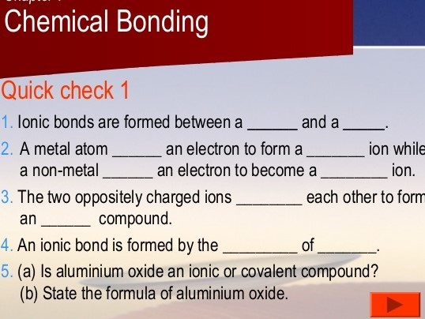

Slide 34
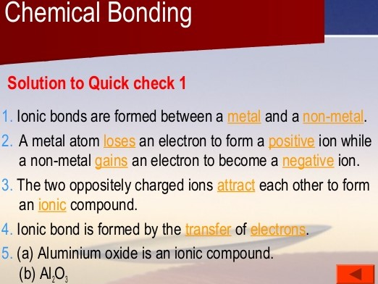

Slide 35
Covalent Bonding
When atoms of non metals form bonds with one another by sharing electrons to achieve the noble gas electronic configuration; covalent bonds are said to be formed between them.
The two nuclei of the bonding atoms are pulled together by the electrostatic attraction between each nucleus and bonding electron pair.
The combining atoms may share one, two or three pairs of electrons.
When the two atoms combine by mutual sharing of electrons, then each of the atoms acquires stable configuration of the nearest noble gas.

Slide 36
Covalent Bonding
Covalent bonding involves electron sharing.
It usually occurs between two nonmetals.
The two nuclei attract the same shared electrons to form a covalent bond.
Orbitals containing the valence electrons overlap to create a common orbital.
It results to the formation of molecular compounds.

Slide 37
Covalent Compounds
The compounds formed due to covalent bonding are called covalent compounds.
The number of electrons which an atom contributes towards mutual sharing during the formation of a chemical bond is called its covalency in that compound.
Covalency of hydrogen in H₂ (H - H) is 1; that of oxygen in O₂ is 2 (O = O), and that of nitrogen in N₂ is three.

Slide 38
Covalent Bonding in Hydrogen Molecule
1s electrons
Shared electron pair
H
H
:
∙
∙
H
H
Two hydrogen atoms
H + H
Hydrogen molecule
H H

Slide 39
Types of electrons in covalent bonding
Bonding Electrons
The pairs of valence electrons involved in the covalent bond formation
Nonbonding Electrons (Lone Pairs of Electrons)
- The pairs of valence electrons not involved in electron sharing
Note: The Lewis structure of a molecule shows atoms by their chemical symbols; covalent bonds by lines; and lone pairs by pairs of dots.
Lewis structures help in understanding the properties of molecules, their shapes and the reactions that they can undergo.
Write the Lewis structure for the “interhalogen” compound chlorine monofluoride, ClF, and state how many lone pairs each atom possesses in the compound.

Slide 40
Bonding and Non bonding Electrons
The valence electrons help each atom achieve a noble-gas configuration
H₂
H∙
∙H
H : H
H
H
..
..
..
..
..
..
F₂
:F∙
∙F:
:F : F:
:F
F:
..
..
..
..
..
..
..
..
..
HF
H∙
∙F:
H : F:
H
F:
..
..
..
bonding
electrons
nonbonding
electrons

Slide 41
Characteristics of a covalent bond
Mode of formation. Covalent bonds are formed due to mutual sharing of one or more pairs of electrons.
Directional character. Covalent bonds are directional in nature.
This is because in a covalent bond, the shared pair of electrons remains localised in a definite space between the nuclei of the two atoms.
This gives a directional character to the covalent bond.

Slide 42
Important terms
Bond Order : Number of electron pairs that are shared between two atoms.
A bond order of 1 represents a single bond.
A bond order of 2 represents a double bond.
A bond order of 3 represents a triple bond.
NB: A bond order of zero means that no bond exists.
The stability of a molecule increases with increase in the bond order. i.e. a molecule with high bond order is more stable than one with less bond order.
Bond Length: The minimum energy distance between the nuclei of two bonded atoms in a molecule.

Slide 43
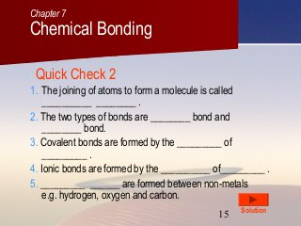
Quick test

Slide 44
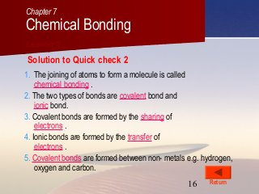
Solution

Slide 45

Single Covalent Bond
A covalent bond formed by mutual sharing of one pair of electrons.
A single covalent bond is represented by a small line (-) between the two atoms.
Bond order is one.

Slide 46
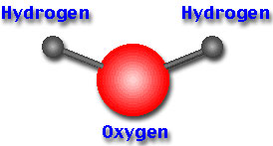
H₂O
H
H
H ∙
.
..
.
H :
:
OR
H
O
O :
O
:
..
..
..
H ∙
Oxygen (O) has six valence electrons.
Gains two more through electron sharing with H.
Achieves a noble-gas configuration.

Slide 47
Formation of ammonia (NH₃)
Electronic configurations of nitrogen and hydrogen are
N 1s² 2s² 2p³ or 2,5
H 1s¹ or 1
Each N atom requires 3 more electrons to acquire a stable noble gas configuration.
Each H-atom requires only 1 electron to achieve the stable He configuration.
Three pairs of electrons between 1 N and 3 H atoms, are mutually shared.

Slide 48
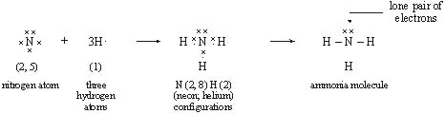
Formation of ammonia (NH₃)
The unshared pair of electrons on the nitrogen atom (in ammonia molecule) is not involved in bond formation and is called a lone pair of electrons.
Since, lone pair of electrons does not take part in bonding, it is also called non-bonding pair of electrons.

Slide 49
Formation of Ammonia
NH₃
H ∙
H
H
.
..
.
H :
:
OR
H
N
H ∙
N
:
N
:
.
..
H
H
H ∙
Nitrogen (N) has five valence electrons
Gains three more through electron sharing with H
Achieves a noble-gas configuration

Slide 50
Formation of Methane
CH₄
H ∙
H
H
H ∙
.
..
∙ C ∙
H :
C
: H
OR
H
C
H
.
..
H ∙
H
H
H ∙
Carbon (C) has four valence electrons.
Gains four more through electron sharing with H.
Achieves a noble-gas configuration.

Slide 51
Single Covalent Bond
Other examples of molecules with single covalent bonds include H₂, Cl₂, HCl, etc.
The bonds formed in each case are single covalent bonds because each of the two atoms involved contribute one electron to the bond.

Slide 52
Double Covalent Bond
The bond formed between two atoms due to the sharing of two electron-pairs is called a double covalent bond or simply a double bond. Two pairs of electrons are equally shared.
It is denoted by two small horizontal lines (=) drawn between the two atoms, e.g., O = O, O = C = O, C₂H₂, etc.
Approximately twice as strong as a single covalent bond between the same two atoms.
Bond order is two.

Slide 53
Double Covalent Bond
CO₂
Carbon has four valence electrons and needs four more
Each oxygen atom has six valence electrons and needs two more
..
:O::C::O:
or
O
C
O
..
Possible for elements that need two electrons
to complete their octet

Slide 54



Formation of oxygen (O₂) molecule.
In a molecule of carbon, two atoms share three electrons -- a triple covalent bond.
Oxygen molecules shares two electrons to make a double covalent bond.

Slide 55
Triple Covalent Bonding
Two atoms share three pairs of valence electrons.
Bond formed due to the sharing of 3 electron-pairs is called a triple covalent bond or a triple bond.
Three small horizontal lines between the two atoms denote a triple bond,
e.g., N ≡ N, and H − C ≡ C- H
Approximately thrice as strong as a single covalent bond between the same two atoms.
Bond order is three.
Bond length decreases with increasing bond order.

Slide 56

Triple Covalent Bonding
Formation of ethyne (C₂H₂) molecule.

Slide 57
Triple Covalent Bonding
N₂
Nitrogen has five valence electrons and needs three
more to complete its octet.
Each nitrogen must share three of its electrons
with the other
:N:::N:
or
:N
N:
Possible for elements that need three or more electrons to complete their octet

Slide 58
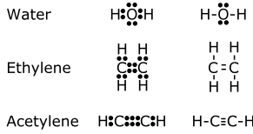
Single, Double and Triple Covalent Compounds
Single covalent
Double covalent
Triple covalent

Slide 59
Properties of Covalent Compounds
Covalent compounds consist of molecules which have a definite shape.
They are gases or volatile liquids because their molecules being electrically neutral are not bound by strong attractive forces.
They have low melting and boiling points because of the weak intermolecular forces.
They readily dissolve in non-polar organic solvents such as benzene, toluene and carbon disulphide. For e.g. iodine, which forms a diatomic non-polar covalent molecule, is insoluble in water, but soluble in ethanol.
Covalent compounds do not conduct electricity. They’re non- electrolytes because the molecules do not contain charged particles.

Slide 60
Comparison Between Single, Double and Triple Covalent Bonds
Single bond is formed by the sharing of 1 electron pair (2-electrons), double bond by 2 electron pairs (4- electrons), whereas a triple bond involves sharing of 3 electron pairs (6- electrons).
In a triple bond, 6 electrons attract the nuclei with greater force. This decreases the distance of separation between the two nuclei.
In a double bond, 4 electrons attract the nuclei with a relatively less force.
In a single bond, 2 electrons hold the nuclei with a still less force than as in double bond.
Therefore, the bond lengths follow the order:
Triple bond length < Double bond length < Single bond length

Slide 61
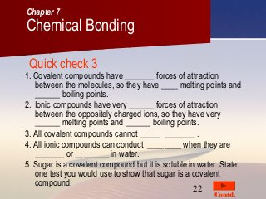
Quick check

Slide 62
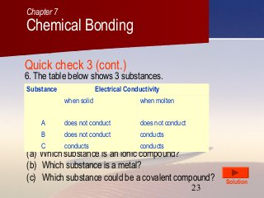
Quick Check

Slide 63
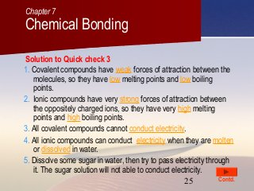
Solution

Slide 64
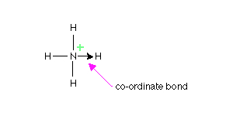
Co-ordinate Covalent (Dative) Bonding
Co-ordinate bonding is a type of covalent bonding (i.e., electron sharing) in which the two shared pair of electrons are both supplied by one of the reacting atoms.
The contributors of these shared electrons are usually neutral molecules which contain lone pair(s) of electrons i.e. a pair of electrons not directly concerned in its existing valency bonds.
Co-ordinate bond is usually shown by an arrow which points from an atom donating the lone pair to the atom that is receiving it.

Slide 65

Co-ordinate Covalent (Dative) Bonding
Examples
Formation of hydronium ion, H₃O⁺
Here, water molecule, H₂O donates a lone pair of electrons into the vacant s orbital of hydrogen ion, H⁺.
H₂O_{(l)} + H⁺_{(aq)} → H₃O⁺_{(aq)}
Note: The complete compounds eventually formed comprise of the three types of bonding, i.e., covalent, co-ordinate and electrovalent.

Slide 66
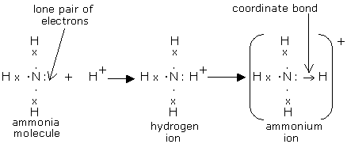
Co-ordinate Covalent (Dative) Bond
2. Formation of ammonium ion, NH₄⁺.
In this ion, ammonia molecule , NH₃ combines by donating its lone pair of electrons into the vacant s orbital of hydrogen ion, H⁺, forming NH₄⁺.
The ammonium ion could then combine with a negative ion, e.g. Cl⁻ by electrovalency to form an ionic compound, NH₄Cl.
Note: In NH₄Cl, there are: formation of NH₃ (covalency); formation of NH₄⁺ (co-ordinate or dative bonding); and formation of NH₄Cl (electrovalency).

Slide 67
Co-ordinate Covalent (Dative) Bonding
Transition metal complexes are formed by these groups donating electrons into the vacant d orbitals of transition metals. In this case, these donor groups are called ligands or coordinating groups or just donors. Example is the hydration of copper II ion
3. Hydration of copper (II) ion
The copper (II) ion accepts four lone pairs of electrons from four water molecules. The blue hydrated ion that results is hydrated copper (II) ion [Cu(H₂O)₄]²⁺
OH₂
Cu²⁺ + 4H₂O [H₂0 Cu OH₂]
2+
OH₂

Slide 68
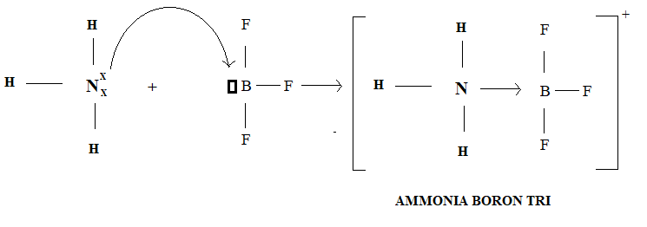
Co-ordinate Covalent (Dative) Bonding
4. Formation Of Ammonia Boron Trifluoride
The nitrogen atom in ammonia donates one pair of electrons to the vacant orbital of boron atom in boron trifluoride thus nitrogen atom is donor atom and boron atom is the acceptor.

Slide 69
Characteristics Of Coordinate Covalent Bond
The atom that shares an electron pair from itself is termed the donor.
The other atom which accepts these shared pair of electrons is known as a receptor or acceptor.
The bond is represented with an arrow →, pointing towards acceptor from the donor atom.
After sharing of electron pair, each atom gets stability.
Getting a good understanding of co-ordinate covalent bonds can help in properly designing complex organic molecules.

Slide 70
Properties Of Coordinate Compounds
Coordinate compounds have lower melting and boiling points than ionic compounds.
Some of these compounds exhibit isomerism.
Sharing of electrons takes place in a definite direction, hence, it is a directional bond.
It is weaker than Ionic bonding.
Co-ordinate covalent bonds are usually formed in reactions that involve two non-metals such as a hydrogen atom or during bond formation between metal ions and ligands.

Slide 71
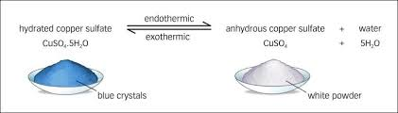
Co-ordinate Covalent (Dative) Bonding
Coordinate bonds are weak.
They can be formed or broken easily with the supply of little amount of energy.
For example, the Cu(II) sulfate is white in color; Copper(II) sulfate pentahydrate is blue in color. The blue color is due to the coordinate bonds formed by 5 water molecules with the Copper(II) ion;
When Copper(II) sulfate pentahydrate is heated, it turns white in color because of the breaking apart of the coordinate bonds.

Slide 72
Question
By drawing an electron dot diagram, show the lone pair effect leading to the formation of ammonium ion from ammonia gas and hydrogen ion. Name the type/s of bond present.

Slide 73

Solution
NH₃ has one lone pair of electrons which it donates to hydrogen atom forming a co-ordinate bond.
The arrow represents a co-ordinate bond. The arrow points from donor to acceptor atom.

Slide 74
Metallic Bonding
Metallic bonding is the collective sharing of a sea of valence electrons between several positively charged metal ions.
responsible for several characteristic properties of metals such as their shiny lustre, malleability, and their conductivities for heat and electricity.
A type of chemical bond in which a ‘cloud’ of free moving valence electrons is bonded to the positively charged ions in a metal.
It can be described as the sharing of free electrons among a lattice of positively charged metal ions.
Note: A metal is the only substance that contains a metallic bond.

Slide 75
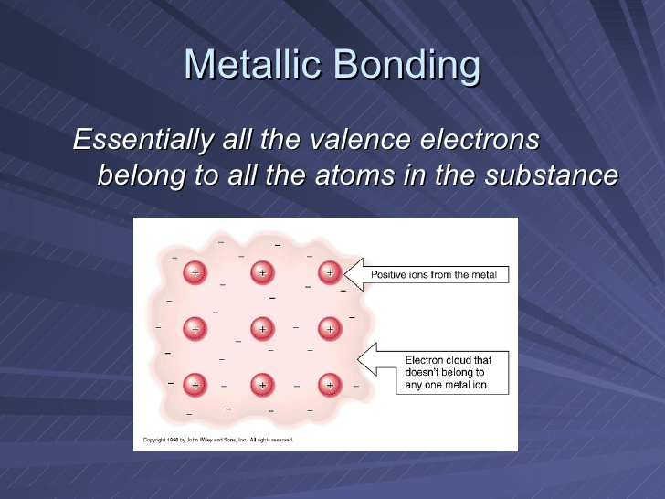
Metallic Bonding

Slide 76
Metallic Bonding
The electrons are detached from the atoms and delocalized throughout the metal, i.e., they move freely.
The interactions between the ions and electrons give rise to a binding force that holds the metallic crystals together.

Slide 77
Properties of metallic bond
The metallic bond is responsible for many of the properties of metals.
Electrical and thermal conductivity: The mobile electrons are charge carriers in the conduction of electricity and energy carriers in heat conduction. Therefore, metals can conduct electricity and heat.
Malleability and ductility: A metal can be hammered into sheets and drawn into wires. These shapes are possible because the atoms share electrons and slide past each other.

Slide 78
Properties of metallic bond
High melting and boiling points: The metallic bond is formed due to the strong electrostatic forces between the sea of electrons and cations. As a result, metals have high melting and boiling points.
Luster and high reflectivity: The delocalized electrons willingly absorb and re-emit visible light. This property gives metals their characteristic luster.

Slide 79
Examples of metallic bonding
Metallic Bonding in Sodium
The electron configuration of sodium is 1s²2s²2p⁶3s¹ . In the solid-state, metallic sodium features an array of Na⁺ ions that are surrounded by a sea of 3s electrons.
However since the sea of electrons is shared by all the sodium cations, quenching the positive charge. , it would be incorrect to think of metallic sodium as an ion.
The softness and low melting point of sodium can also be explained by the relatively low number of electrons in the electron sea and the relatively small charge on the sodium cation.

Slide 80
Examples of metallic bonding
Metallic Bonding in Magnesium
Metallic magnesium consists of an array of Mg²⁺ ions. Its electron sea contains twice the number of electrons than the one in sodium (since two 3s electrons are delocalized into the sea).
Due to the greater magnitude of charge and the greater electron density in the sea, the melting point of magnesium (~650ºC) is significantly higher than that of sodium.

Slide 81
Examples of metallic bonding
Metallic bonding in transition elements
Transition metals tend to have particularly high melting points and boiling points.
The reason is that they can involve the 3d electrons in the delocalisation as well as the 4s.
The more electrons you can involve, the stronger the attractions tend to be.

Slide 82
Examples of metallic bonding
The metallic bond in molten metals
In a molten metal, the metallic bond is still present, although the ordered structure has been broken down.
The metallic bond isn't fully broken until the metal boils.
That means that boiling point is actually a better guide to the strength of the metallic bond than melting point is.
Note: On melting, the bond is loosened, not broken.

Slide 83
Exceptions to octet rules
The octet rule tells us that eight electrons fill the outer shell of an atom to give a noble gas ns² np⁶ valence-shell configuration.
The octet rule accounts for the valences of many of the elements and the structures of many compounds.
Carbon, nitrogen, oxygen, and fluorine obey the octet rule rigorously, provided there are enough electrons to go around.

Slide 84
Exceptions to octet rules
An atom of phosphorus, sulfur, chlorine, or other nonmetals in Period 3 and subsequent periods can accommodate more than eight electrons in its valence shell.
In addition, when the central atom in a molecule has empty d-orbitals, it may be able to accommodate 10, 12, or even more electrons.
The electrons in such an expanded valence shell may be present as lone pairs or may be used by the central atom to form additional bonds.
The exceptions to the octet rule can be recognized as follows:

Slide 85
Exceptions to octet rules
Radicals
Species having electrons with unpaired spins are called radicals.
Some species have an odd number of valence electrons, and so at least one of their atoms cannot have an octet.
They are generally highly reactive.
One example is the methyl radical, .CH₃, which is so reactive that it cannot be stored. The single unpaired electron is indicated by the dot on the C atom in .CH₃.

Slide 86
Exceptions to octet rules
Methyl radical (.CH₃) occurs in the flames of burning hydrocarbon fuels.
Cigarette smoke is an extremely complex chemical composition and contains numerous toxic and carcinogenic substances, including many polycyclic aromatic hydrocarbons (PAHs).
PAHs are a class of compounds composed of two or more fused benzenoid rings known for their carcinogenic and mutagenic properties. There are more than five hundred different PAHs in tobacco smoke (Rodgman A. and Perfetti T.A. The chemical components of tobacco and tobacco smoke. Boca Raton, FL: CRC Press; 2009. pp. 1–110).

Slide 87
Exceptions to octet rules
Biradicals
A biradical is a molecule with two unpaired electrons. The unpaired electrons are usually on different atoms.
In that biradical, one unpaired electron is on one carbon atom of the chain and the second is on another carbon atom several bonds away.
In some cases, though, both electrons are on the same atom.
One of the most important examples is the oxygen atom itself. Its electron configuration is [He]2s² 2p_{x}² 2p_{y}¹ 2p_{z}¹ .
The O atom has two unpaired electrons, and so it can be regarded as a special type of biradical.

Slide 88
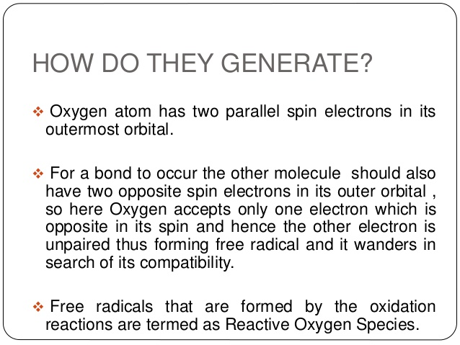

Slide 89
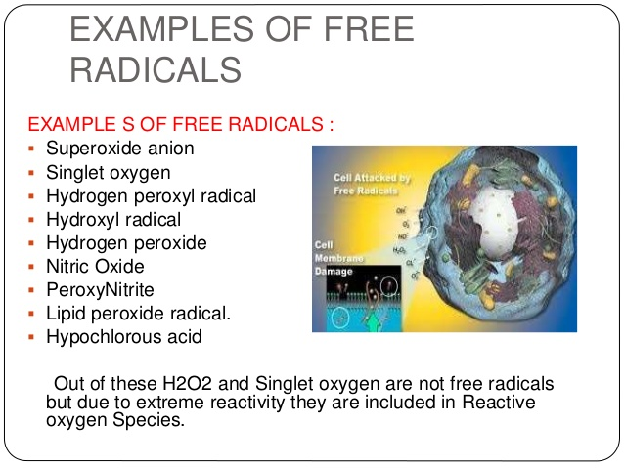

Slide 90
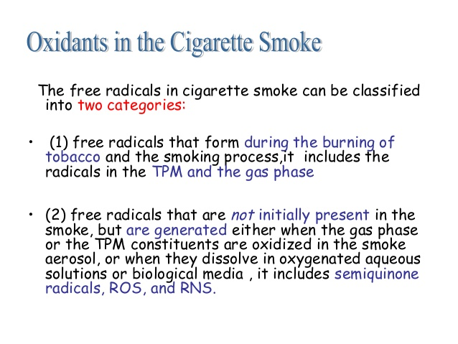
TPM – Total Particulate Matter
ROS – Reactive Oxygen Species
RNS – Reactive Nitrogen Species

Slide 91
